Slide 1

Frugal 3D Point Cloud Model Training via Progressive Near Point Filtering and Fused Aggregation
Donghyun Lee | Yejin Lee | Jae W. Lee | Hongil Yoon
eudh1206@snu.ac.kr | yejinlee@snu.ac.kr | jaewlee@snu.ac.kr | hongilyoon@google.com

Slide 2
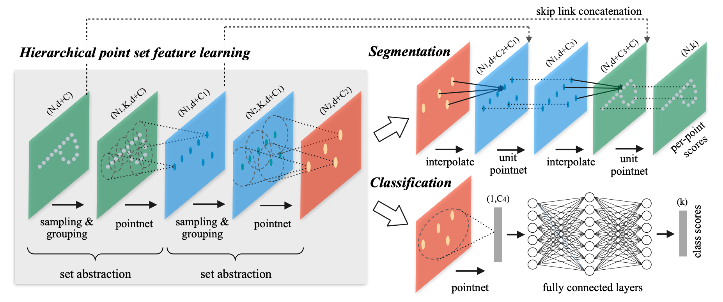
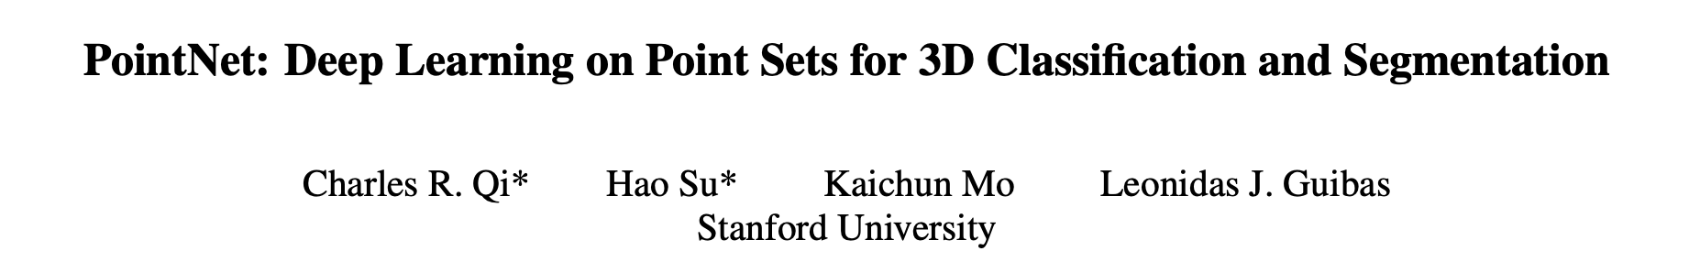
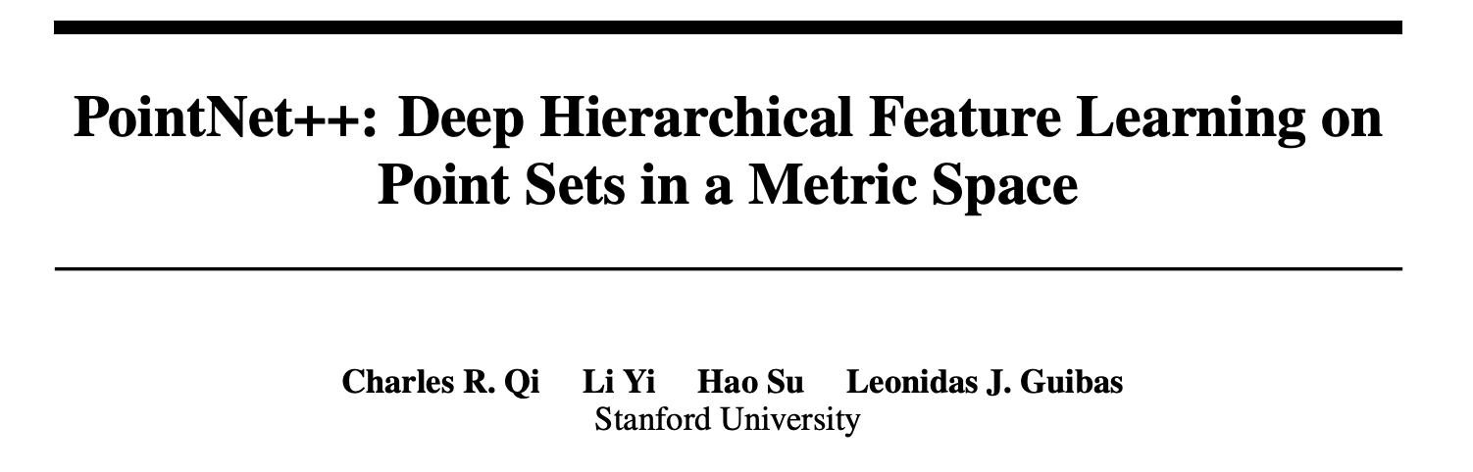
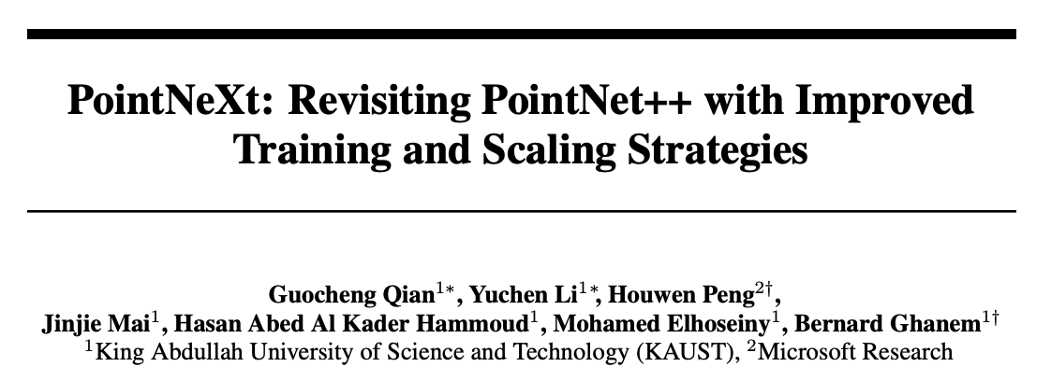
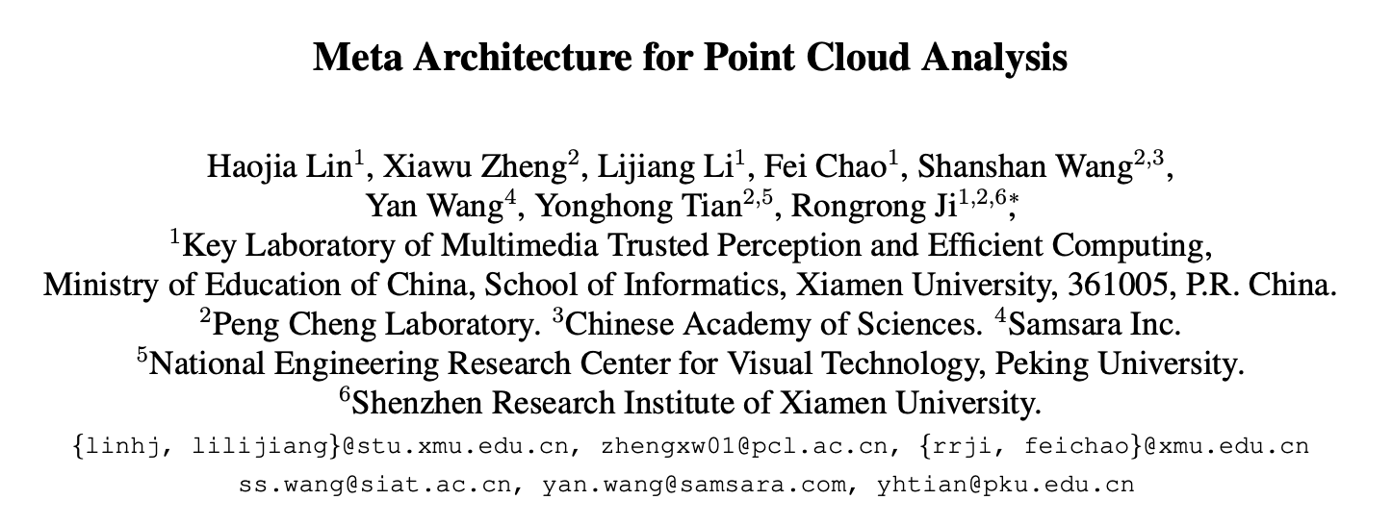
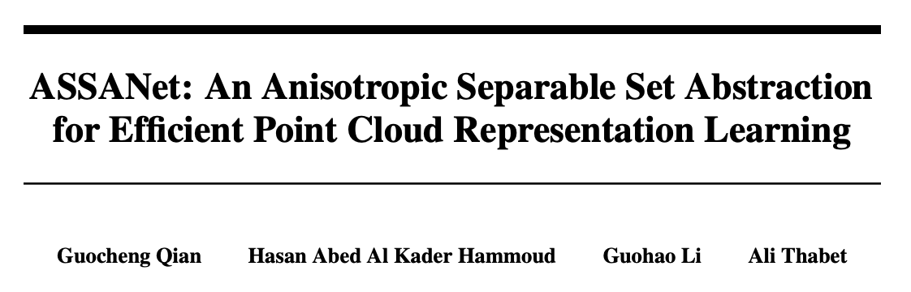
Deep Neural Networks for 3D Point Cloud
PointNet and PointNet++ are the first to apply DNN to raw 3D point cloud without preprocessing.
Various ideas have been proposed, continuously enhancing the model performance and computational efficiency.
Figures from Qi, C.R. et al. “PointNet++: Deep Hierarchical Feature Learning on Point Sets in a Metric Space”

Slide 3



Challenges in 3D Point Cloud Model Training
Challenges
d ↑ the size of models & datasets → ↑ training cost for 3D point cloud models
Performance Bottleneck
Farthest Point Sampling (FPS): Takes up average 44.69% of overall training time.
Aggregation: Takes up average 22.84% of overall training time.
Our Proposal
#1. L-FPS: Eliminates redundant distance calculation of FPS in the training pipeline.
#2. Fused Aggregation: Reduce redundant memory accesses during aggregation.

Slide 4

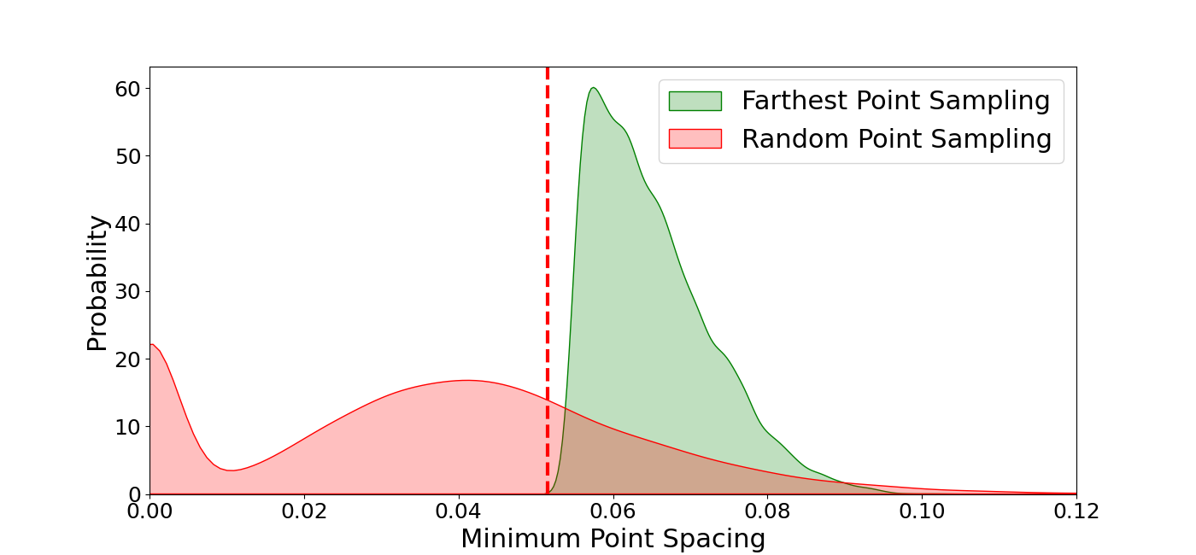
Farthest Point Sampling - Observations
Observation #1. FPS in the training process incurs a significant number of redundant distance calculations across epochs.
Observation #2. The key factor in achieving high-quality sampling is to ensure a minimum spacing among the sampled points, and this information can be obtained in advance, prior to training.
P0
P2
P1
P7
P3
P8
P4
P6
threshold
P9
P5
threshold

Slide 5
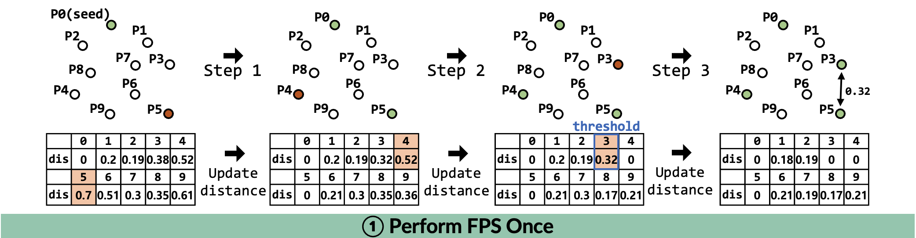
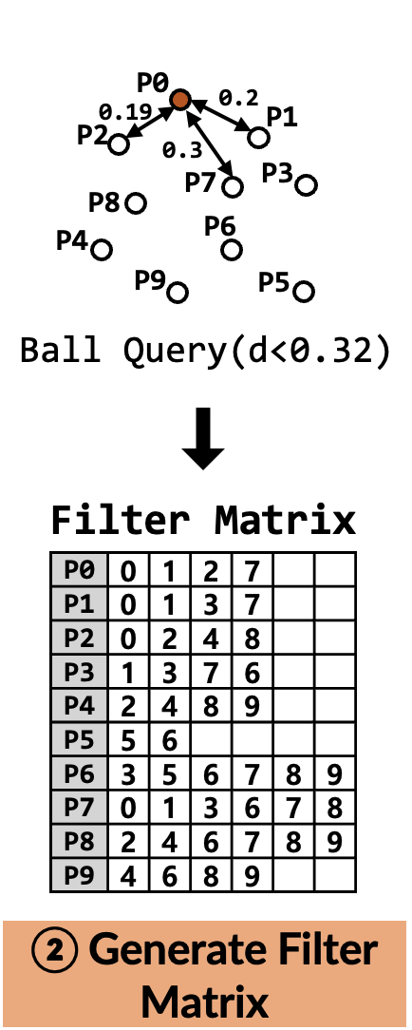

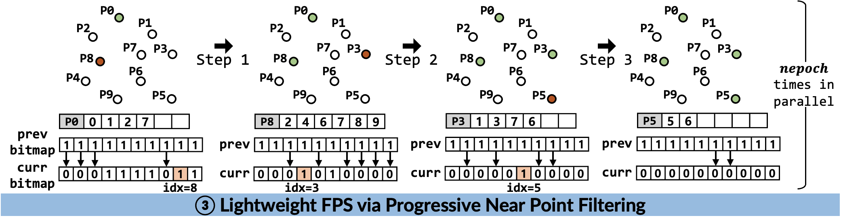
Technique #1. Lightweight FPS (L-FPS)
We propose Lightweight FPS via Progressive Near Point Filtering.
Good Sampling Quality
Minimum spacing among the sampled points are ensured.
Enough Randomness
Points are randomly selected every iteration in progressive near point filtering.

Slide 6
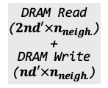
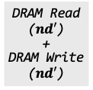
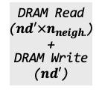
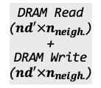
Aggregation - Observations
Observation #1. There are redundant memory accesses to intermediate values in forward and backward passes.
❶ Group
❷ Max
Reduction
Backpropagated
Gradients
❸ Scatter
❹ Sum Reduction
Next Layer Gradient
Point Feature
Output Point
Feature
$$d′$$
$$d′$$
G_{P1}
$$d′$$
P1
P2
P3
P4
...
Pi
...
P1
$$d′$$
$$d′$$
$$d′$$
P2
O1
G1
Gn
G_{P2}
G1’
P3
G_{P3}
$$n_{neigh.}$$
G2’
$$N$$
$$n_{neigh.}$$
...
$$n$$
$$n$$
...
G3’
Pi
G_{Pi}
...
G4’
...
...
On
$$N$$
P1
G_{P1}
Gi’
P3
G_{P3}
...
Neighbor
Index Table
DRAM Read
($nd′×n_{neigh.}$)
+
DRAM Write
($nd′×n_{neigh.}$)
P4
DRAM Read
($nd′×n_{neigh.}$)
+
DRAM Write
($nd′$)
DRAM Read
($nd′$)
+
DRAM Write
($nd′$)
G_{P4}
DRAM Read
($2nd′×n_{neigh.}$)
+
DRAM Write
($nd′×n_{neigh.}$)
O1(1,2,3,… i)
. . .
On(1,3,4,… i)
Pi
G_{Pi}
1. Forward Pass (Group and Max Reduction)
2. Backward Pass (Scatter and Sum Reduction)
[Forward] “$3nd^{′}×n_{neigh.}+nd^{′}$” memory access
[Backward] “$3nd^{′}×n_{neigh.}+2nd^{′}$” memory access
Notes:
Next, we look at Aggregation.
The forward pass of aggregation is composed of grouping and max reduction, while the backward pass requires scatter and sum reduce operation.
We observe that there are redundant memory access to the intermediate values in these operations.

Slide 7
Aggregation - Observations
Observation #2. Ineffectual computations are performed in the backward pass.
❶ Group
❷ Max
Reduction
Backpropagated
Gradients
❸ Scatter
❹ Sum Reduction
Next Layer Gradient
Point Feature
Output Point
Feature
$$d′$$
$$d′$$
G_{P1}
$$d′$$
P1
P2
P3
P4
...
Pi
...
P1
$$d′$$
$$d′$$
$$d′$$
P2
O1
G1
Gn
G_{P2}
G1’
P3
G_{P3}
$$n_{neigh.}$$
G2’
$$N$$
$$n_{neigh.}$$
...
$$n$$
$$n$$
...
G3’
Pi
G_{Pi}
...
G4’
...
...
On
$$N$$
P1
G_{P1}
Gi’
P3
G_{P3}
...
Neighbor
Index Table
DRAM Read
($nd′×n_{neigh.}$)
+
DRAM Write
($nd′×n_{neigh.}$)
P4
DRAM Read
($nd′×n_{neigh.}$)
+
DRAM Write
($nd′$)
DRAM Read
($nd′$)
+
DRAM Write
($nd′$)
G_{P4}
DRAM Read
($2nd′×n_{neigh.}$)
+
DRAM Write
($nd′×n_{neigh.}$)
O1(1,2,3,… i)
. . .
On(1,3,4,… i)
Pi
G_{Pi}
1. Forward Pass (Group and Max Reduction)
2. Backward Pass (Scatter and Sum Reduction)

Slide 8
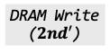
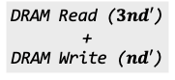
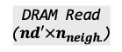
Technique #2. Fused Aggregation
We propose Fused Aggregation, which significantly reduces redundant memory accesses.
Point Feature
❶ Fused
Group
❷ Max
Reduction
Output Point
Feature
Backpropagated
Gradients
❸ Fused Scatter & Sum Reduction
Next Layer Gradient
$$d′$$
$$d′$$
P1
P2
P3
P4
...
Pi
...
P1
$$d′$$
$$d′$$
$$d′$$
P2
$$n_{neigh.}$$
O1
G1
Gn
G1’
P3
...
...
G2’
$$N$$
$$n$$
$$n$$
G3’
Pi
SRAM
G4’
...
...
On
$$N$$
P1
Source Idx Table
Source Idx Table
Gi’
Neighbor
Index Table
P3
I1
i | 1 | 2 | 2 | i | i
1 | 1 | 1 | i | 4 | 4
I1
i | 1 | 2 | 2 | i | i
1 | 1 | 1 | i | 4 | 4
...
P4
...
Saved for backwards
...
DRAM Read ($3nd′$)
+
DRAM Write ($nd′$)
O1(1,2,3,… i)
. . .
On(1,3,4,… i)
DRAM Read
($nd′×n_{neigh.}$)
DRAM Write
($2nd′$)
Pi
In
In
1. Forward Pass (Fused Group and Max Reduction)
2. Backward Pass (Fused Scatter and Sum Reduction)
[Forward] Memory access reduced from “$3nd^{′}×n_{neigh.}+nd^{′}$” to “$nd^{′}×n_{neigh.}+2nd^{′}$”
[Backward] Memory access reduced from “$3nd^{′}×n_{neigh.}+2nd^{′}$” to “$4nd^{′}$”

Slide 9
Evaluation
Dataset | Model | Accuracy (Stdev.)
 |  | Baseline | L-FPS
S3DIS | PN++ | 63.19 (0.54) | 63.39 (0.34)
 | MB-L | 69.82 (0.40) | 69.76 (0.40)
 | MB-XL | 70.67 (0.37) | 70.74 (0.43)
ScanNet | PN++ | 59.42 (0.26) | 59.54 (0.57)
 | MB-L | 70.52 (0.27) | 70.54 (0.31)
 | MB-XL | 71.78 (0.28) | 71.74 (0.44)
NVIDIA RTX 3090
Accuracy Max 0.06 mIoU loss, potential mIoU gain of 0.2
Throughput 2.25x end-to-end speedup

Slide 10
Frugal 3D Point Cloud Model Training via Progressive Near Point Filtering and Fused Aggregation
Please contact to the author or refer to the full paper for more details
http://arc.snu.ac.kr/pubs/eccv24_pointcloud.pdf
Donghyun Lee | Yejin Lee | Jae W. Lee | Hongil Yoon
eudh1206@snu.ac.kr | yejinlee@snu.ac.kr | jaewlee@snu.ac.kr | hongilyoon@google.com
Sourced code available at https://github.com/SNU-ARC/Frugal_PN_Training

